Slide 1
Utilizing Machine Learning & Regression Analysis to Analyze Flood Insurance Data
MGT 6203 Proposal Presentation
By (order of presentation):
Hossein Daneshvar
Warda Aziz Khan
Mahshid Jafar Pour
Anh Tran
April 2022

Slide 2
HosseiN

Slide 3
Outline
Problem Statement
Dataset(s)
Data engineering
Data exploration through visualization
Data cleaning
Imputation
Feature selection and feature engineering
Modeling
Linear regression
Stepwise method
Penalized Linear Regression
Principal Component Analysis (PCA)
Regression Tree
Conclusions

Slide 4


Problem Statement
Damage caused by floods is covered under the policy issued by National Flood Insurance Program (NFIP), overseen by FEMA (Federal Emergency Management Agency).
Flooding is the primary vector of economic damages inflicted on local communities. There is also a projected increase in destructive flooding due to climate change; therefore, there is an enormous need to efficiently distribute financial risk.
Our target variable is the insurance premium. We are trying to answer the following questions:
How do flood zone, elevation, property state, no. of floors and other features affect insurance premium? Can we predict premium based on the variables available?
What is the correlation between different variables?
What are the most important variables in premium estimation?

Slide 5

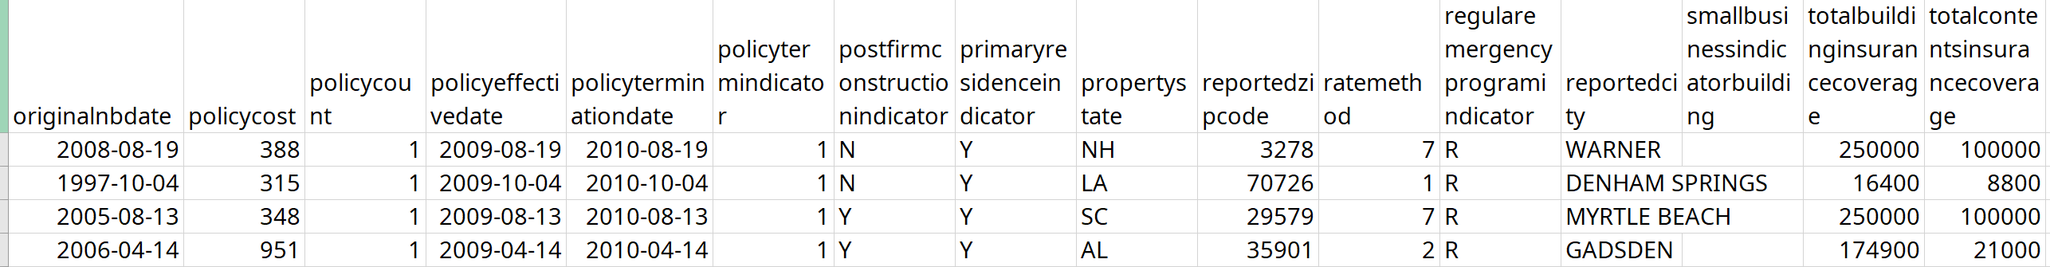
Data
The main dataset: FEMA's National Flood Insurance Policy Database (https://www.kaggle.com/lynma01/femas-national-flood-insurance-policy-database)
More than 50,000,000 rows
Limited the analysis to Houston, TX data (2,029,540 rows)
Supplementary data: 2,000,000 rows of Claims (https://nfipservices.floodsmart.gov/reports-flood-insurance-data)

Slide 6
Warda

Slide 7
Steps in Data Analysis
Visualization and understanding data
Data Filtering/Cleaning
Feature Selection & Feature Engineering
Modeling

Slide 8
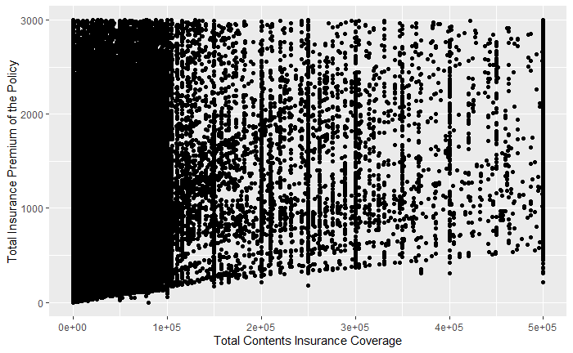
Visualization and understanding data
Visualization to
understand the data

Slide 9
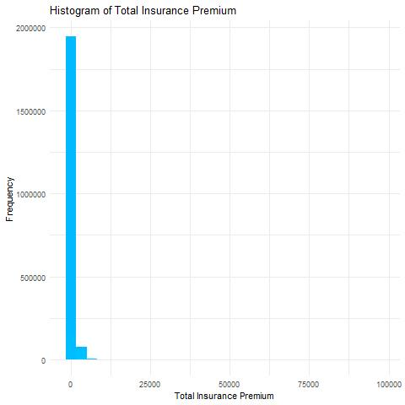
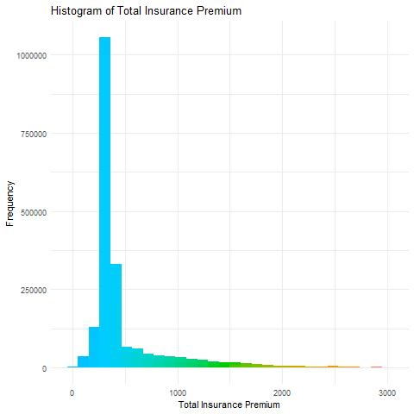
Data Filtering/Cleaning
Data Filtering/Cleaning
Right data formatting
Outlier removal
Removed columns with more than 60% data missing
Imputing missing data with mean, 0 and mode
Created dummy variables for categorical features

Slide 10
Steps in Data Analysis
Visualization and understanding data
Data Filtering/Cleaning
Outlier removal
Removed columns with more than 60% data missing
Imputing missing data with mean, 0 and mode
Right data formatting
Created dummy variables for categorical features
Feature Selection & Feature Engineering
Correlation matrix
VIF
Stepwise regression
LASSO regression
PCA
Feature transformation (log and cubic root)
Modeling
Linear model
More advanced models such as Random Forest and SVM

Slide 11
Mahshid

Slide 12
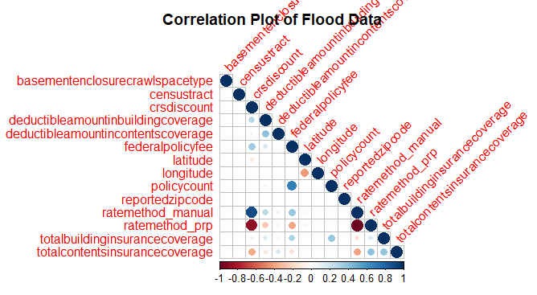
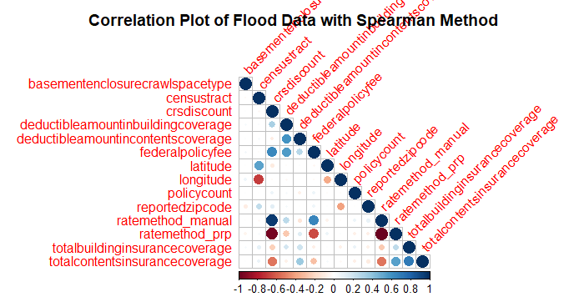
Feature Selection & Feature Engineering
After data cleaning and visualization:
Explored both linear and Spearman relationship between features and omitted the features that are highly correlated (cut-off > 0.6)
Explored non-linear transformation of data: logarithmic and cubic root transformation
Omitted featured with VIF above 10.
Stepwise regression (AIC as metric) and LASSO regression (5-fold cv) were performed for further feature selection.
Reduced 44 variables, many of which in categorical format, to 22 through the above steps

Slide 13
Feature Selection & Feature Engineering
Feature selection and transformation improved R² of linear regression from 0.35 to 0.44.
All the features are significant based on linear regression
The final dataset: still large; ~2 million rows with 21 features.
Due to computational demand, data were filtered for the top most frequent zipcodes: 77096, 77089, 77084, 77024 and 77062. More complicated models are run only on this subset of data which is still large (~293,794 rows) .

Slide 14
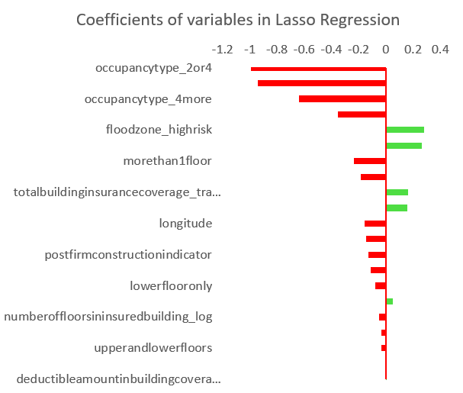
Linear Regression model
Train-test split: 70% - 30%
Stepwise: forward and both direction; AIC as a metric, all variables significant; R² = 0.498
Penalized Linear Regression (Ridge & Lasso): occupancy type has the strongest negative effect on the target variable, following by “elevatedbuildingindicator”.
Risk zone and construction with basement have positive coefficient, resulting in an increase in the total insurance premium

Slide 15
Anh

Slide 16
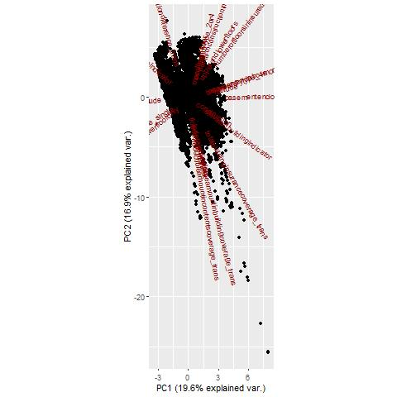
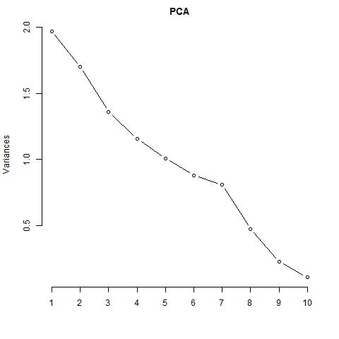
Principal Component Analysis (PCA)
PCA was run on the remaining 21 variables. From standard deviations of each PC and screeplot it was concluded that 7 to 10 PCs are sufficient to account for 88% to 96% of variability respectively.
R² with 7 PCs and 10 PCs is 0.397 and 0.463 respectively.

Slide 17
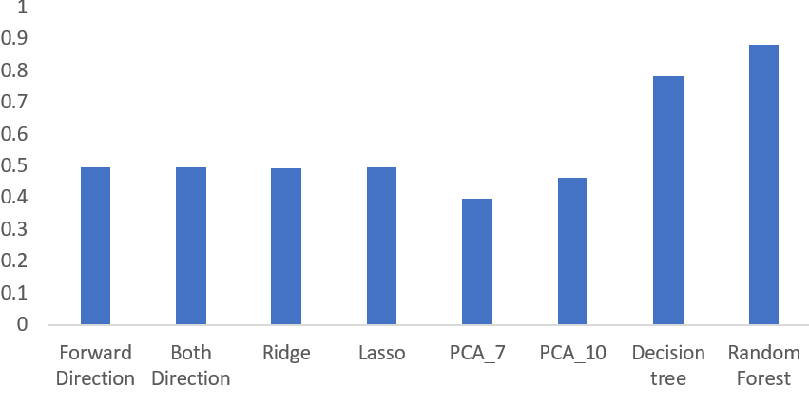

Tree-based Regression
Decision Tree: input: 21 variables;
only 4 variables (“federalpolicyfee”, “floodzone_highrisk”, “elevationdifference_trans” and “totalbuildinginsurancecoverage_trans”) were included in the model
12 terminal nodes.
R2 = 0.784
Random Forest:
500 weak regression trees
R2 = 0.884
R²

Slide 18
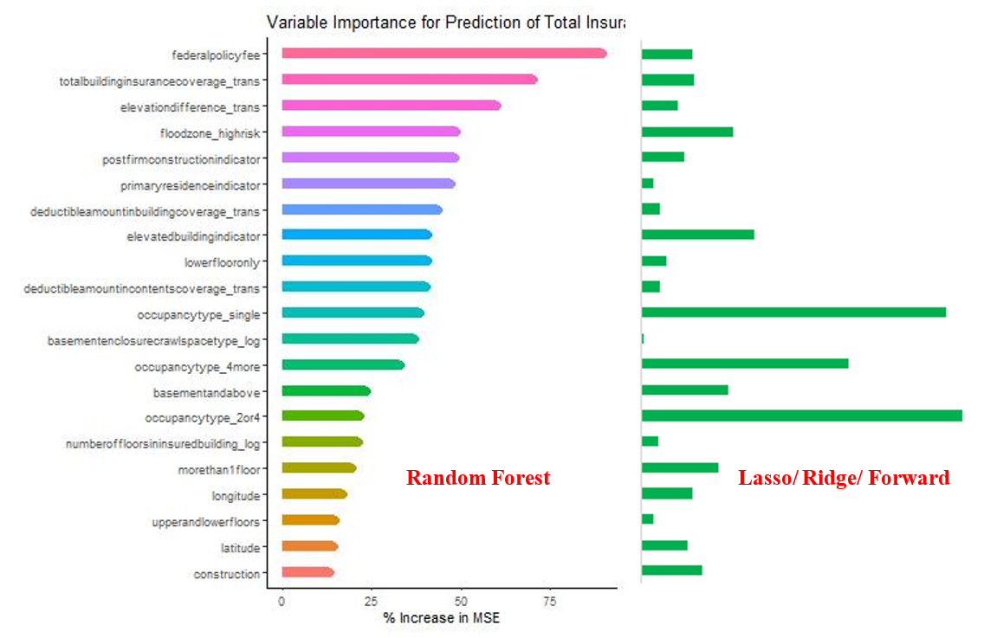
Comparison of linear & Tree-based Regressions

Slide 19
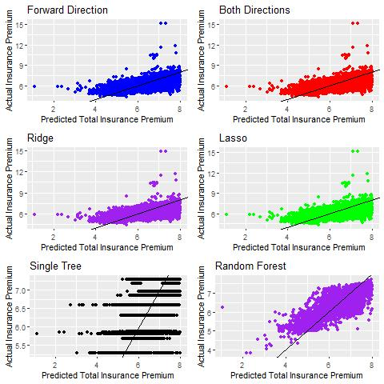
Conclusions
The most important features based on linear regression are:
Occupancy type (3 dummy variables),
Elevated building indicator, and
Floodzone_high risk.
Random Forest shows the highest predictive power. Based on this model the following are the most important features in predicting insurance premium:
Federal policy fee,
Total building coverage,
Elevated building indicator, and
floodzone_high risk.

Slide 20
Refreneces
[1] Munich Re. NatCatSERVICE https://natcatservice.munichre.com/ (2019).
[2] Winsemius, H. C. et al. Global drivers of future river flood risk. Nat. Clim. Change 6, 381–385 (2016).
[3] Davis, S. A. & Skaggs, L. L. Catalog of Residential Depth-Damage Functions used by the Army Corps of Engineers in Flood Damage Estimation IWR-92-R-3 (USACE Institute for Water Resources, Fort Belvoir, VA, 1992).
[4] Wing, O.E.J., Pinter, N., Bates, P.D. et al. New insights into US flood vulnerability revealed from flood insurance big data. Nat Commun 11, 1444 (2020).
[5] Bübeck, P., de Moel, H., Bouwer, L. M. & Aerts, J. C. J. H. How reliable are projections of future flood damage? Nat. Hazards Earth Syst. Sci. 11, 3293–3306 (2011).
[6] Merz, B., Kreibich, H., Schwarze, R. & Thieken, A. Review article “Assessment of economic flood damage”. Nat. Hazards Earth Syst. Sci. 10, 1697–1724 (2010).
[7] McGrath, H., El Ezz, A. A. & Nastev, M. Probabilistic depth–damage curves for assessment of flood-induced building losses. Nat. Hazards 97, 1–14 (2019).
[8] Lehman, W. & Nafari, R. H. An empirical, functional approach to depth damages. E3S Web Conf. 7, 05002 (2016).
[9] Karapiperis, Dimitris & Kunreuther, Howard & Lamparelli, Nick & Maddox, Ivan & Kousky, Carolyn & Surminski, Swenja & Dolese, Ned & Patel, Paresh & Larkin-Thorne, Sonja. (2017). Flood Risk and Insurance. 10.13140/RG.2.2.27243.13608.
[10] Congressional Research Service: Informing the legislative debate since 1914. (2021). National Flood Insurance Program: The Current Rating Structure and Risk Rating 2.0. https://crsreports.congress.gov
[11] https://nfipservices.floodsmart.gov/reports-flood-insurance-data
[12] https://www.kaggle.com/lynma01/femas-national-flood-insurance-policy-database
[13] Zuur, A.F., Ieno E.N., Elphick C. S., A protocol for data exploration to avoid common statistical problems, Methods in Ecology & Evolution, (2010)

Slide 21
Thank you!

